Slide 1
What is Conversation?
Conversation at its simplest takes place when participants perform these tasks:

Slide 2
:
1) Open a channel. When participant A sends an initial message, the possibility for conversation opens. For conversation to follow, the message must establish common ground; it must be comprehensible to participant B.

Slide 3
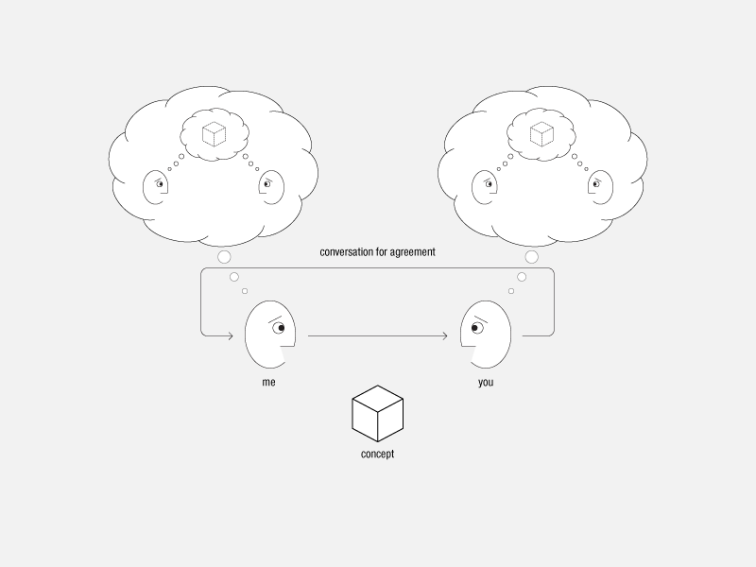

Slide 4
Conversation for Agreement:
As a result of conversation, participants agree on their understanding of a concept in that they share a similar model, and they believe that they agree.

Slide 5
2) Commit to engage.
Participant B must pay attention to the message and then commit to engaging with A. Such a commitment may amount to nothing more than continuing to pay attention. For conversation to persist, the commitment must be symmetrical, and either side may break off for any reason, at any time. Put another way, each participant must see value in continuing the conversation, which offsets the personal cost of being engaged: what we call the “bio-cost,” or the energy, time, attention, and stress required [3].
3) Construct meaning.
Conversation enables us to construct (or reconstruct) meaning, including meaning that is new to the destination. Conversation theory has a highly detailed model that we must leave to other descriptions though it is useful even in this skeletal form [4].

Slide 6
4) Evolve.
Participant A or B (or both) are different after the interaction. Either or both hold new beliefs, make decisions, or develop new relationships, with others, with circumstances or objects, or with themselves.
Here we define an “effective conversation” as an interaction in which the changes brought about by conversation have lasting value to the participants.

Slide 7
5) Converge on agreement.
Participant B may wish to confirm understanding of A’s concept. To do so, B must create and transmit a different formulation of the topic(s) under discussion, one that captures his model of the concept. On receipt, participant A attempts to make sense of B’s formulation and compares it with her original intention. This may lead to further exchanges. When both A and B judge that the concepts match sufficiently, they have reached “an agreement over an understanding.” Such agreement may involve a fact about the world or merely shared belief. Sometimes participants agree on the qualities of a song, or that they like each other enough to continue talking.

